Slide 1

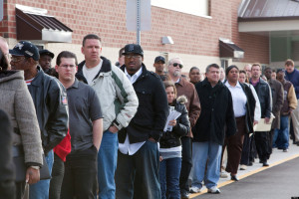
Opportunities and challenges of real-time economic measurement
Erica L. Groshen
Cornell U. –ILR
Washington Center for Equitable Growth
October 27, 2021
Notes:
Begin by saying “Thanks Luke and organizers”

Slide 2

Agenda
Agenda
Official statistics are data infrastructure
COVID’s impact on official statistics
  Data users
  Statistical agencies
Lessons for future
Notes:
US econ conditions
Labor market (UR, jobs, EPOP, participation, wages, by demographic group)
Recovery from COVID
Outlook
Risks (upside and down)
Dramatic headline numbers
Payroll jobs
Unemployment rate
Beyond headlines—disruptions
Looking forward
Recovery prospects
Need for data

Slide 3

Agenda
Official statistics are data infrastructure
Public good (non-rival & non-excludable)
Essential for democracy, market economy, prosperity
  Inform public and private decisions
  Promote consensus
Undersupplied by private sector;
necessary role for government
Notes:
US econ conditions
Labor market (UR, jobs, EPOP, participation, wages, by demographic group)
Recovery from COVID
Outlook
Risks (upside and down)
Dramatic headline numbers
Payroll jobs
Unemployment rate
Beyond headlines—disruptions
Looking forward
Recovery prospects
Need for data

Slide 4
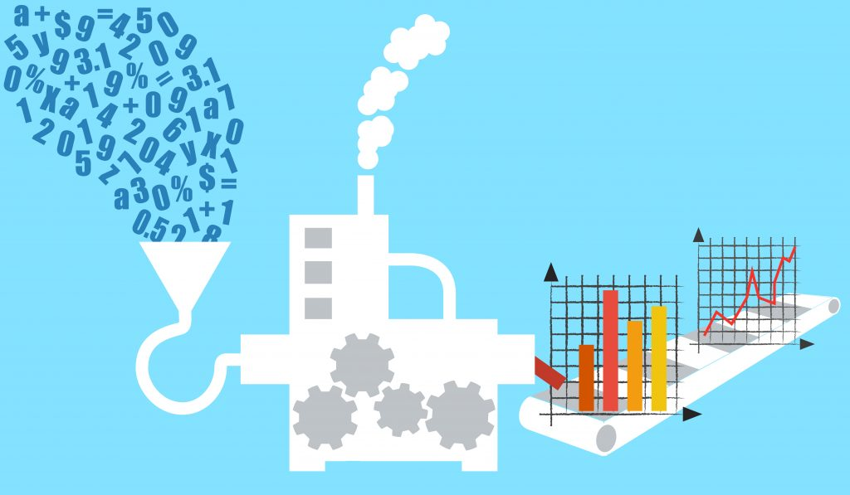
COVID’s impact on official statistics

Slide 5
COVID has been extraordinary:
job losses vs. post-WWII recessions
1990
Abrupt, deep decline
Spread contained, initial steep recovery
Inconsistent recovery thereafter
Source: Bureau of Labor Statistics (Current Employment Statistics) and author’s calculations. Seasonally adjusted.
Notes:
Deeper, steeper, more widespread
What will recovery look like—another jobless recovery?

Slide 6

Data user experience
Which users
  Congress, Executive Branch, Federal Reserve, state and local government
  Financial markets
  Businesses
  Households
  Nonprofits, etc…
Uses
  Design and administer policy to fight virus
  and provide economic relief
  Assess policy effectiveness
  Understand long-term consequences
  Inform investment

Slide 7

Data users wanted more
Granularity (demographic, geographic, occupation, industry…)
Timeliness and frequency
Agility to ask new questions
Consistency across products for linking & combining data series
Assured independence from political influence
Privacy protection
To better inform decisions
and target policy

Slide 8

Data user responses
Creative analysis of official stats
  Linking, merging, modelling, mining neglected series…
  Journalists and policymakers, especially….
New private sector data products
  JPM Chase, ADP, Indeed, …
Government administrative releases
  UI Initial Claims, state UI data,…

Slide 9







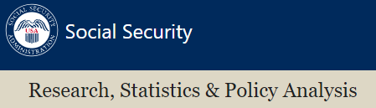




Stat agency experience
Met production challenges
  Shifted to virtual data collection
  Transparent about impact on data quality
New analysis in every program?
New questions on existing products
  BLS Current Population Survey COVID questions
New products
  Census Pulse Surveys
  BLS Business Survey
Funded by low travel; wished they
could have done more

Slide 10

Lessons for future

Slide 11
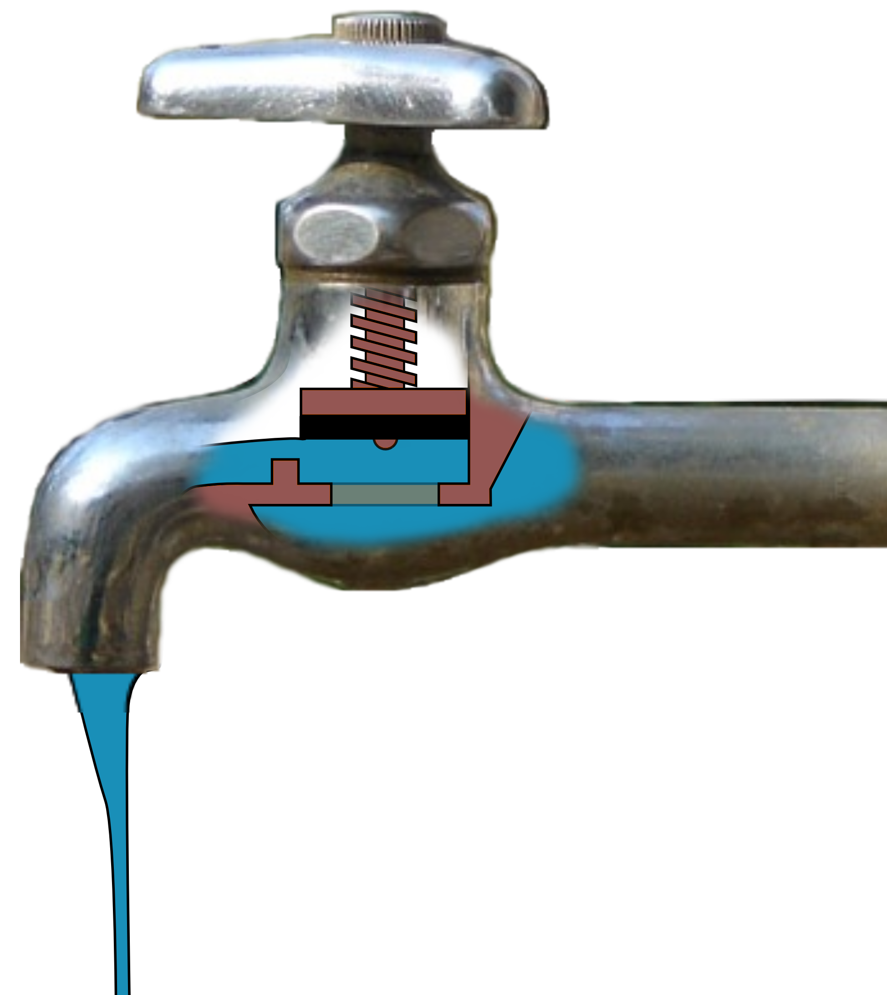
Lesson 1: Tap more government administrative data
Ongoing effort: Evidence-based Policy Commissions, Evidence Act, and Advisory Committee on Data for Evidence Building (ACDEB)
Improve access for statistics, policy analysis, program evaluations, and monitoring
Allow routine sharing of data with and across statistical agencies
National Secure Data Service for merging/linking
confidential data
Example of potential -- UI data

Slide 12

Example: Use UI wage and claims records
Enhance records
  Add job title, hours, work location, demographics
  Adopt T3 JEDx standards (https://www.t3networkhub.org/learn-more)
Bureau of Labor Statistics (BLS) funds and supervises data curation
  Also funds state analytics to guide local policy and private decisions
BLS uses records
  Improve existing products: ↑ granularity and ↑ timeliness in JOLTS, payroll jobs and more
  New products: improved mass layoff statistics, claims records reports…
  Shrink BLS surveys: OES, National Compensation Survey
https://www.ilr.cornell.edu/work-and-coronavirus/public-policy/pandemic-racial-inequities-underscore-need-better-labor-market-data

Slide 13
Lesson 2: Partner with private sector statistics
Not “or,” but “and”
  Government and private initiatives are complements, not competitors
Official | Private
Transparent, known statistical properties Access to comprehensive, sensitive government data High survey response rates Objective Long history | Proprietary methods Speedy production Quick innovation Access to transactional data Tailored to special needs
Notes:
So, how does BLS stack up compared to non-governmental Big Data sources?
BPP is a daily price index developed at MIT using online prices.
Advantages:
timeliness of a daily price index
large sample sizes
However, BPPs does not price the same representative bundle on a daily basis.
Use sampling weights from our Consumer Expenditure Survey – our source of cost weights in the CPI.
Because they have no source of sampling weights for the prices that they collect from the web.
Will Big Data replace the need for Official statistics? NO!
Billion Prices and CPI serve different informational needs.
CPI measures changes in the cost of living for a representative consumer purchasing a representative market basket—all critical to serving the policymakers, social security recipients and hundreds of programs that use the CPI to adjust benefit levels or thresholds.
We are transparent in a way that is inconsistent with protecting profit-making intellectual property.
Because we are a part of government, have a secure environment and have access to sensitive administrative data:
We can get and verify that we have a representative sample.
We can match sensitive information from our respondents to administrative records and other sources.

Slide 14



Requires managing public/private data partnership opportunities and risks
Quality
    Bias
    Production-grade
Access
    Cost
    Risks that data stream can change
Legal framework
    Privacy
    Security
    Quid pro quo
Notes:
Before we go forward with alternative data sources, we need to assess opportunities and risks.
To explain, consider a steel producer metaphor
We produce high-quality steel.
Big data = a new iron mine, with costs:
Mining that data
Determining its carbon content
Turning it into high-quality steel.
Because we ultimately focus on cost-effective production of high-quality steel, we may not be able to use the new mine if costs are too high or if the ore is low quality, or if the mine is likely to flood excessively
So, how does BLS stack up compared to non-governmental Big Data sources?

Slide 15

Lesson 3: Coordinate US statistical agencies better
One agency cannot do this alone
Collect stat agencies outside of Cabinet, under US Chief Statistician
  Use common inputs, concepts, aggregations, access points, privacy protocols, arrangements with data providers…
  Share services (IT, training, legal,…)
  Preserve missions
  Reinforce independence
  Fund adequately and dependably

Slide 16
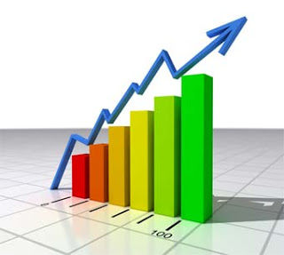
Conclusions
Official statistics are data infrastructure
COVID clarifies need for better official statistics
  Kudos to stat agencies for what they did!
  Users want more granularity, timeliness, agility….
We can have better statistics
  Use administrative data better
  Partner with private sector
  Reorganize/coordinate statistical agencies
↑ Prosperity!

Slide 17
Erica L. Groshen
Cornell-ILR
erica.groshen@gmail.com
Resources
BLS: www.bls.gov, sign up for e-alerts or Twitter
UI record enhancement: https://www.ilr.cornell.edu/work-and-coronavirus/public-policy/pandemic-racial-inequities-underscore-need-better-labor-market-data
Notes:
Thank to host and the audience!

Slide 18
Bonus slides

Slide 19

Help improve official statistics
Don’t free ride—speak up for evidence and official statistics
  Participate in federal surveys; encourage others
  Attest to trustworthiness; debunk attacks
  Cite your sources
  Support funding and modernization
  Join Friends of BLS via www.friendsofbls.org,
  LinkedIn: “Friends of BLS” group,
  Twitter: @Friends_of_BLS
Notes:
If you see it, decry political interference—it hurts us all.
Be sure to speak up for official statistics
The fight for integrity in economics is not one the stats agencies can win alone. They need your help.
I encourage all of you, as trusted voices, to speak up for the integrity of Federal statistics.
When you allow uninformed criticism (or cheap shots, nihilism, sloppy work or cheap laughs) to stand, you undermine all of the work – including yours! – that relies on our data.
Your job is to speak up or the data and the integrity of the data will disappear.
Participate in surveys and encourage others to do the same. And thank those who do!!
Support the recommendations of the Ryan-Murray Commission on Evidence-based Policymaking.
Tell your elected officials how important it is to have good data for your decision-making!
Third, regardless of industry, occupation, or any other distinction that may land you in one of our survey samples, it is your participation in BLS surveys that keep them as accurate and timely as possible. If you are asked to participate in a BLS survey, please do so.

Slide 20
Unemployment rate in 2020-2021 (percent of labor force)
Max UR (estimated) during Great Depression
Official unemployment rate + maximum impact of misclassifications
April 2020: largest 1-month
jump in series, +10.3 ppts
Max UR during
Great Recession
Official unemployment rate
------------------------------ 2020 ------------------------------------------- -------------------- 2021 ------------------
Source: Bureau of Labor Statistics (Current Population Survey). Seasonally adjusted.
Notes:
Counts people, not jobs
April--largest 1-month jump in series, to 14.7%

Slide 21
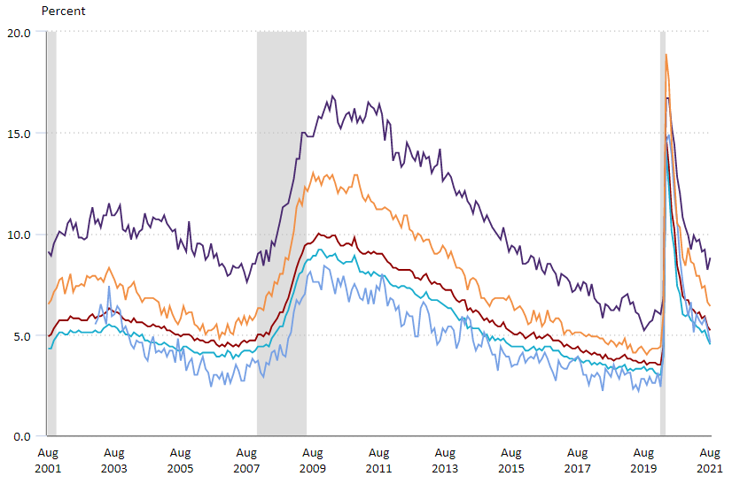
Unemployment rates differ by race
Black and Hispanic workers’ unemployment rises more than White workers’ unemployment
August 2021
Black/Af.Am: 8.8%
Hispanic/Latino: 6.4%
US: 5.2%
Asian: 4.6%
White: 4.5%
Source: Bureau of Labor Statistics. Seasonally adjusted. Shaded areas denote recession months.

Slide 22
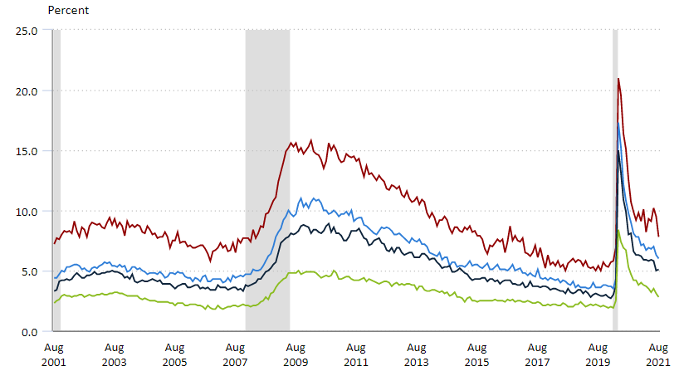
Unemployment rose more for the less educated
August 2021
LT high school: 7.8%
High school: 6.0%
Some college: 5.1%
BA or more: 2.8%
Source: Bureau of Labor Statistics. Seasonally adjusted. Shaded areas denote recession months.

Slide 23

COVID-specific measure for job loss
Headline measures cannot track everything
All ways workers’ jobs disrupted
  Layoffs
  Unofficial layoffs (with job, not at work)
  Short hours
  Leave the labor force
How many retain employer-employee connection?

Slide 24
COVID-19 disrupted workers
Headline UR understates disruptions (flux)
Ties to employers are falling—slows recovery
2020
2021
Source: Bureau of Labor Statistics and author’s calculations.
Notes:
2 points:
Headline UR and job losses are only half of disruptions
Disruptions with connection to employers were ¾ to begin with, now, barely half.
Nonwhite unemployment and disruption rates rise much more than whites’.
Female unemployment and disruptions rise more that males’.

