Slide 1
The Federal Reserve and Income Inequality
©
Emma Coleman Jordan
J. Crilley Kelly and Terry Curtin Kelly Professor of Business Law
© 2020 by Emma Coleman Jordan

Slide 2
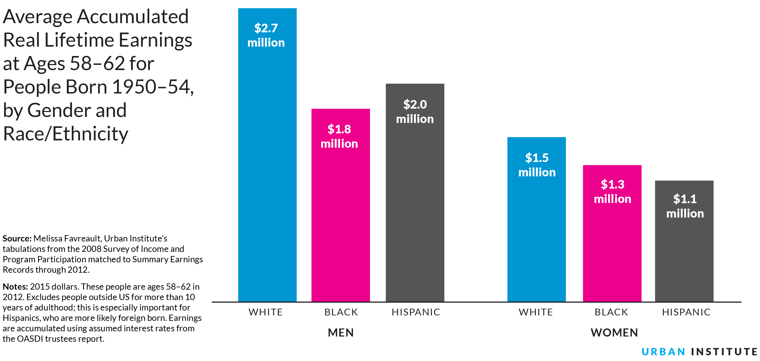
A Backdrop: Income and Assets Compounded
Chart from CNN Money, June 2011; data from Federal Reserve: https://money.cnn.com/2011/06/09/news/economy/household_wealth/index.htm
https://apps.urban.org/features/wealth-inequality-charts/
© 2020 by Emma Coleman Jordan
Notes:
From the Urban Institute: “People with lower earnings may have a harder time saving. The average white man earns $2.7 million over a lifetime, while the average black man earns $1.8 million and the average Hispanic man earns $2.0 million. The difference in lifetime earnings is lower for women: the average white woman earns $1.5 million, while the average black woman earns $1.3 million and the average Hispanic woman earns $1.1 million. These disparities partly reflect historical disadvantages that continue to affect later generations.”
Pew data addresses similar trends but has not provided an update since 2016. However, according to the Institute for Women’s Policy Research, the inflation-adjusted earnings of Black women fell by 2.8 percent between 2017 and 2018. https://iwpr.org/publications/gender-wage-gap-2018/ According to the Economic Policy Institute, throughout the wage distribution percentiles, black–white wage gaps were larger in 2018 than in 2000. This data also confirms that general wage inequality continues to rise because highest-wage workers have experienced the strongest growth. https://www.epi.org/publication/state-of-american-wages-2018/

Slide 3
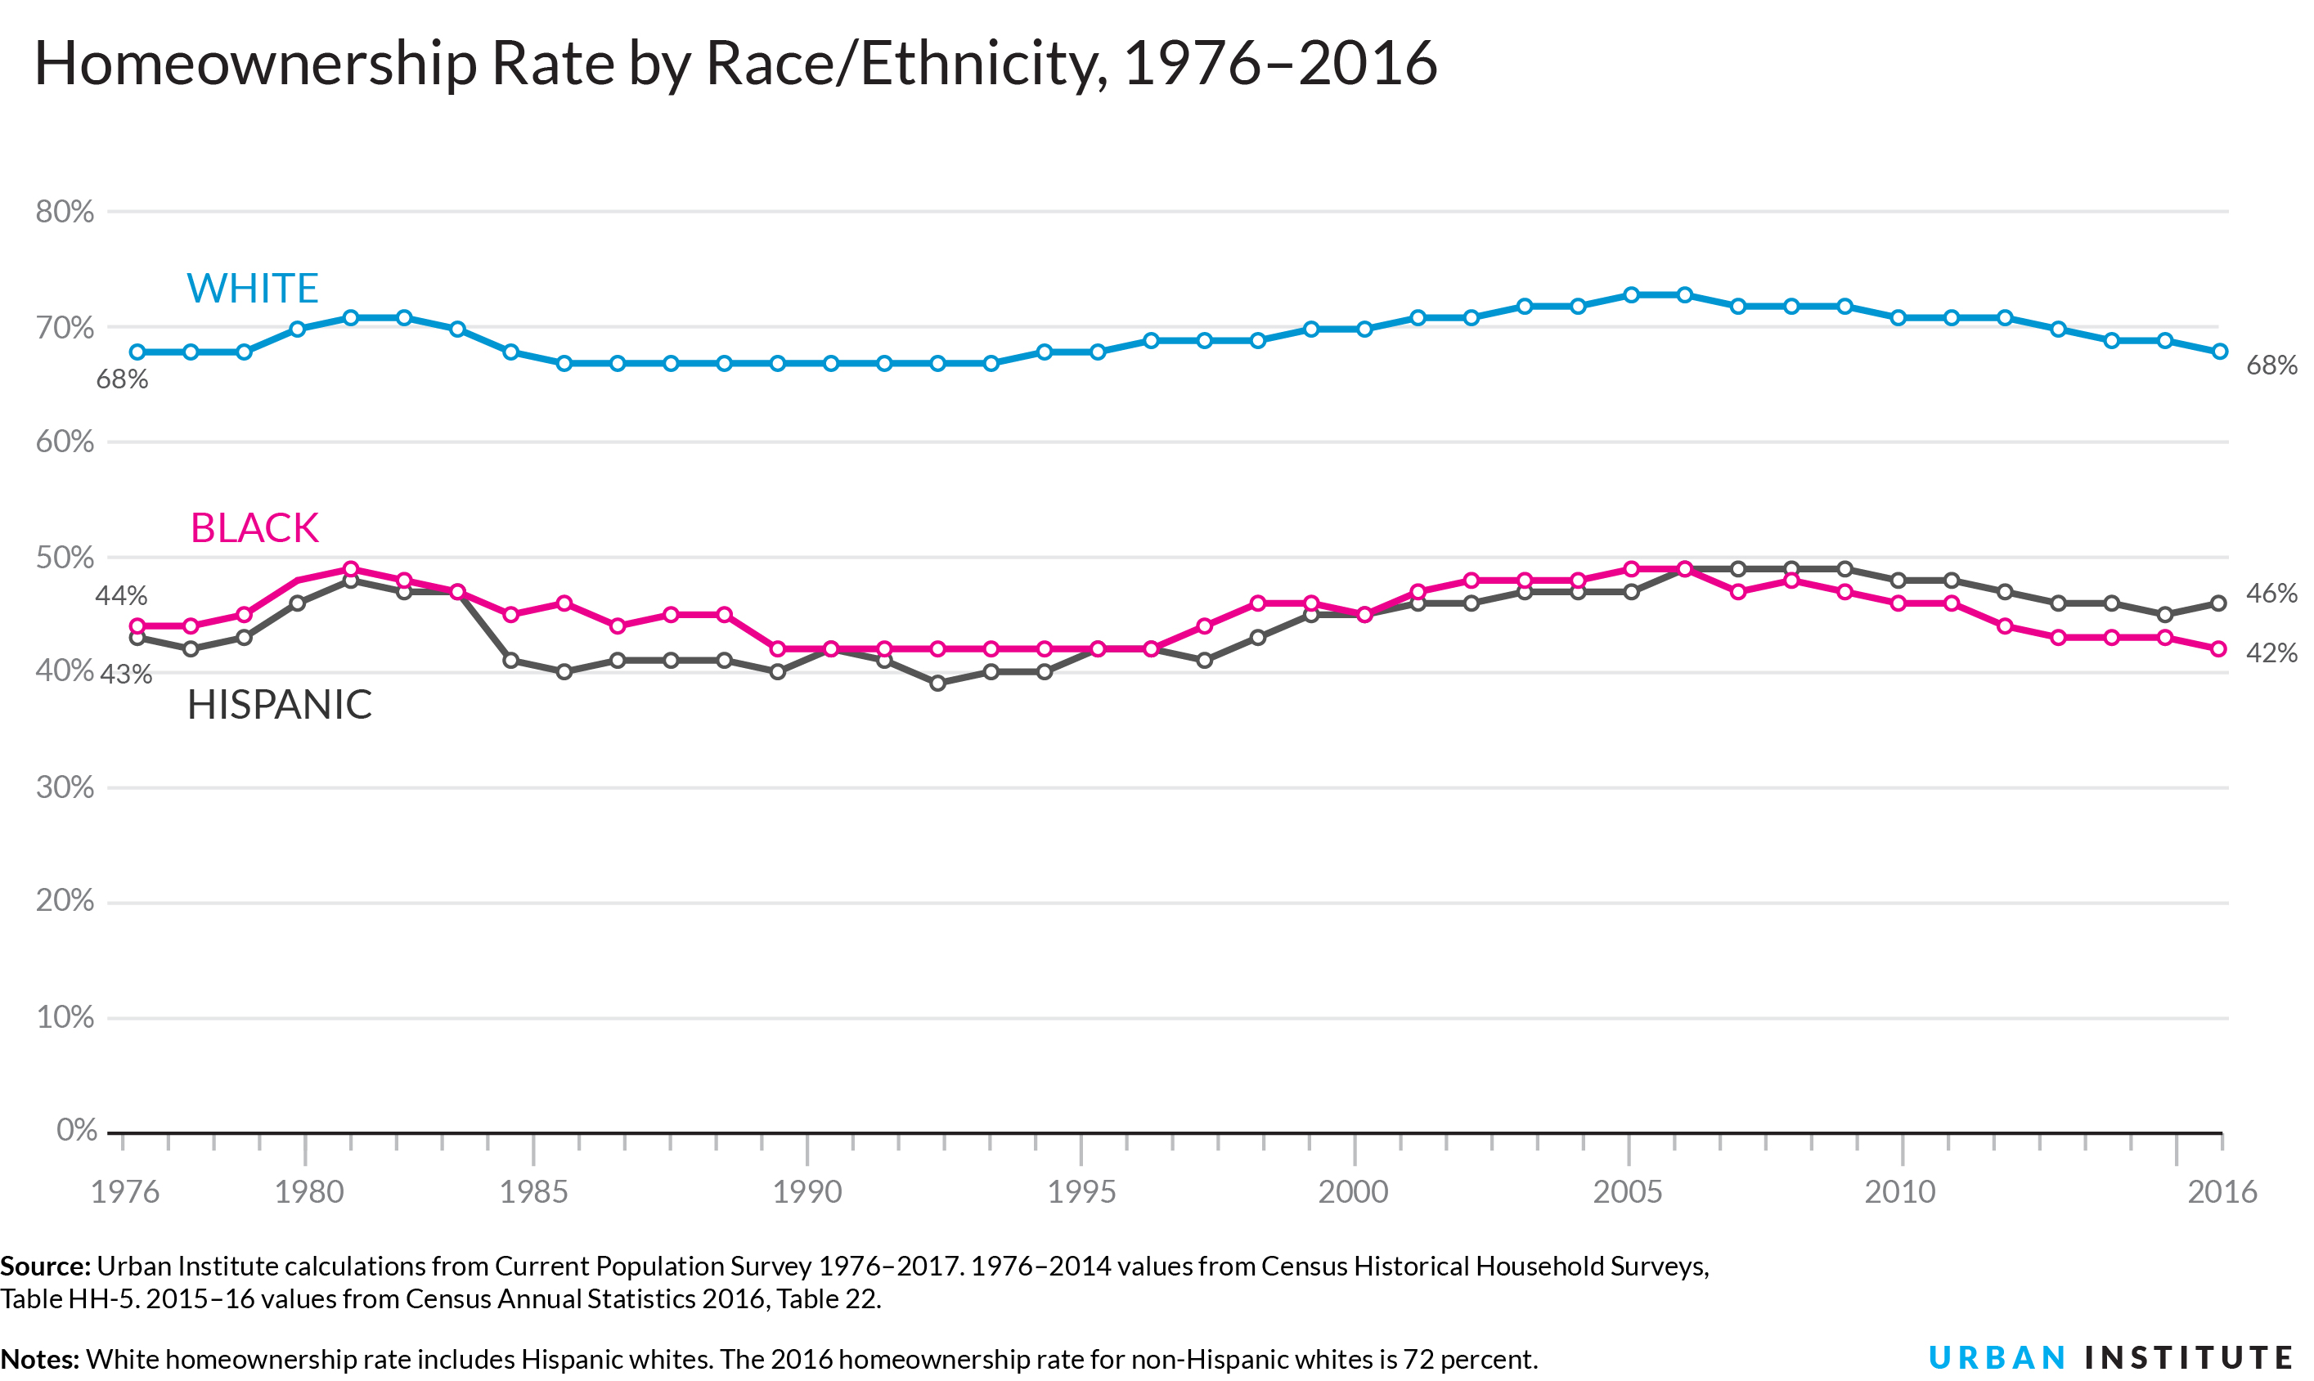
A Backdrop: Income and Assets Compounded
https://apps.urban.org/features/wealth-inequality-charts/
© 2020 by Emma Coleman Jordan
Notes:
This chart reflects data up until 2016, when homeownership rates were as follows: White – 68%; Hispanic – 46%; Black – 42%. Note that in 1976, when data is first available for the purposes of this chart, the rates were as followed: White – 68%; Hispanic – 44%; Black – 43%.
According to 2018 data from the Census Bureau’s Housing Vacancies and Homeownership Survey (CPS/HVS), in the fourth quarter of 2018 the black homeownership rate grew by 0.6 percent to 43.6%. In comparison, the white (non-Hispanic) homeownership grew by 0.9 percent to 73.6% in the fourth quarter, more than the all minority homeownership rate. http://eyeonhousing.org/2019/03/homeownership-rates-by-race-and-ethnicity/

Slide 4
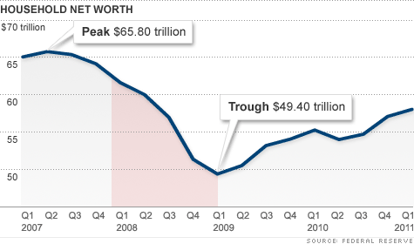
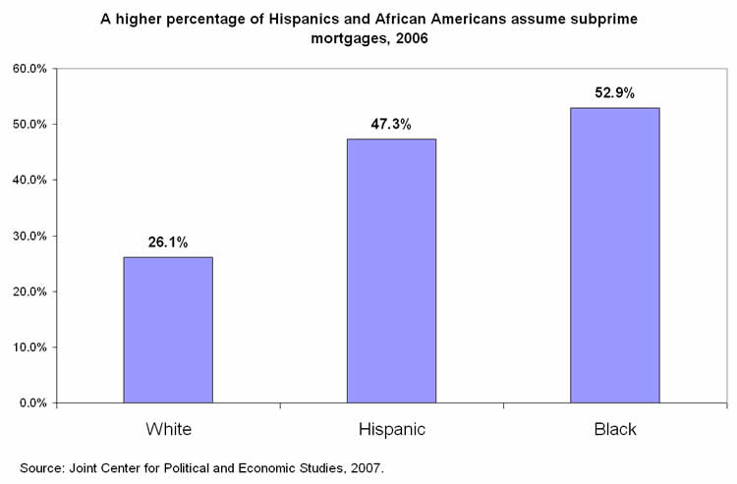
The Fed’s Role
Deregulation
Off-balance-sheet permissions
Racial steering
Resulting decline in household net worth: $16.4 trillion
Cognitive narrowness
Chart from CNN Money, June 2011; data from Federal Reserve: https://money.cnn.com/2011/06/09/news/economy/household_wealth/index.htm
Subprime crisis response
TPS (next slide)
© 2020 by Emma Coleman Jordan
Bulleted Text Style Title— Helvetica Neue 20pt Bold
Notes:
Note on household income: According to a Pew report from Jan 2020, median household in 2015 was the same as in 2000, a 15-year failure to increase. However, from 2015 to 2018, the annual average growth rate was 2.1%. For comparison, the average annual growth rate from 1970 to 2000 was 1.2%. https://www.pewsocialtrends.org/2020/01/09/trends-in-income-and-wealth-inequality/
Chart source: CNN Money, “America’s Lost Trillions,” https://money.cnn.com/2011/06/09/news/economy/household_wealth/index.htm
Chart source: EPI, “Subprime mortgages are nearly double for Hispanics and African Americans,” data from Joint Center for Political and Economic Studies, 2007, https://www.epi.org/publication/webfeatures_snapshots_20080611/

Slide 5
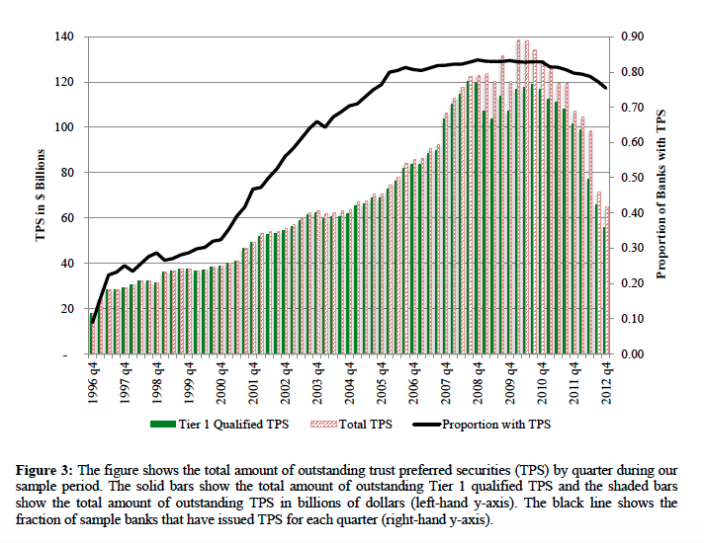
Source: Nicole Boyson et al, available at http://www.nber.org/papers/w19984.pdf
© 2020 by Emma Coleman Jordan
Bulleted Text Style Title— Helvetica Neue 20pt Bold
Notes:
Source: Nicole Boyson, Rüdiger Fahlenbrach & René Stulz, Why do Banks Practice Regulatory Arbitrage? Evidence from Usage of Trust Preferred Securities at 4 (Nat’l Bureau of Econ. Research, Working Paper No. 19984, 2014), available at http://www.nber.org/papers/w19984.pdf

Slide 6
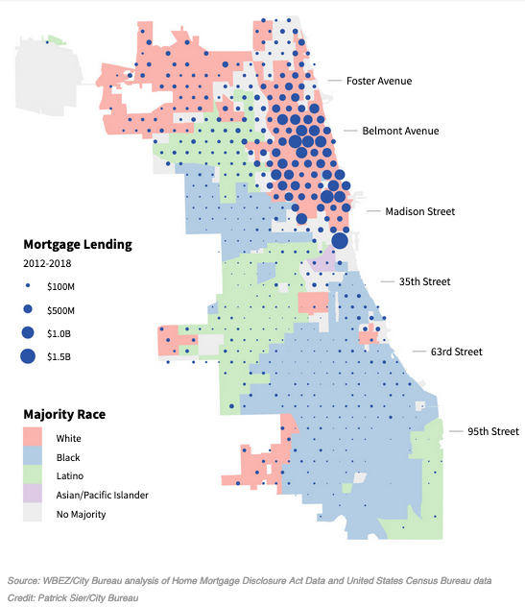
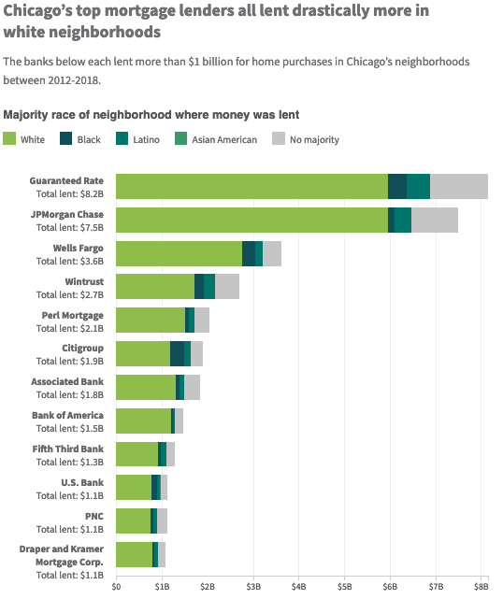
Cognitive Blindness and Deregulation
Source: WBEZ, June 2020, https://interactive.wbez.org/2020/banking/disparity/
© 2020 by Emma Coleman Jordan
Notes:
Both charts from June 2020, https://interactive.wbez.org/2020/banking/disparity/
From same source: “68.1% of dollars loaned for housing purchases went to majority-white neighborhoods, while just 8.1% went to majority-black neighborhoods and 8.7% went to majority-Latino neighborhoods. In other words, for every $1 banks loaned in Chicago’s white neighborhoods, they invested just 12 cents in the city’s black neighborhoods and 13 cents in Latino areas. That’s despite the fact that there are similar numbers of majority-white, black and Latino neighborhoods in the city.”

Slide 7
Janet Yellen
Federal Reserve Chair, 2014-2018, at her 2013 confirmation hearing
“Economists have spent a lot of time trying to understand what is responsible for widening inequality…. There is a lot of research, a lot of debate about exactly what the causes of this problem are, perhaps having to do in part with the nature of technological change, with . . . globalization and the decline of unions…. What can the Fed do? We cannot change all of those trends.”
© 2020 by Emma Coleman Jordan

